Slide 1
MODIS + Landsat phenology, LAI timeseries analysis

Slide 2
LAI timeseries analysis – GEE harmonic fitting

Slide 3
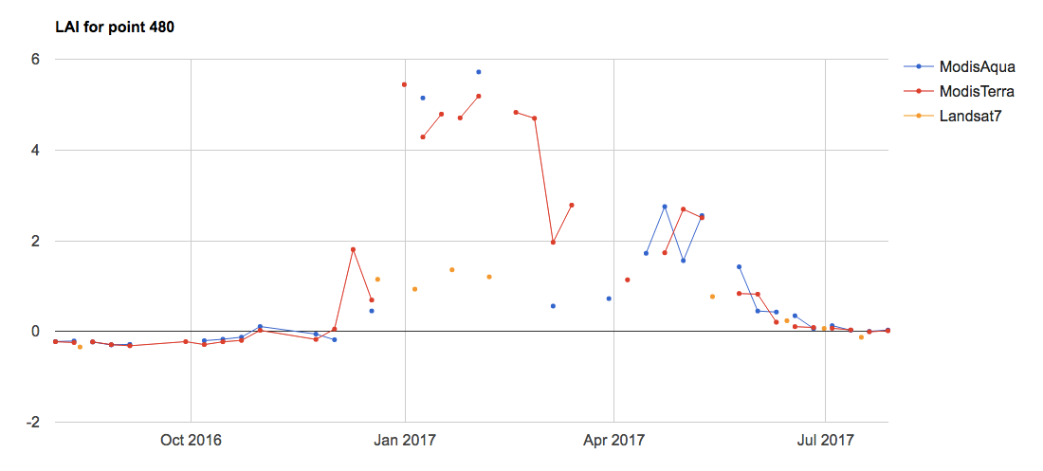
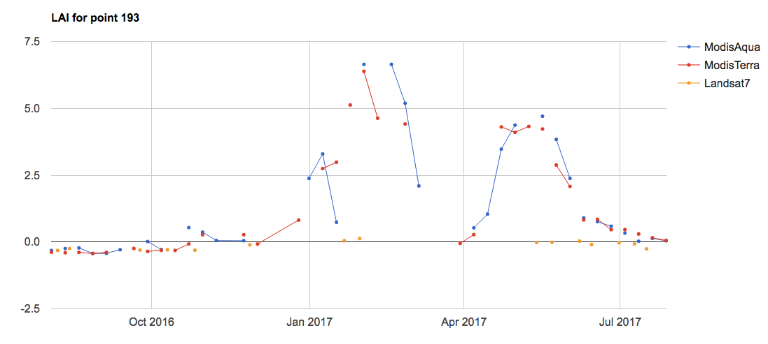
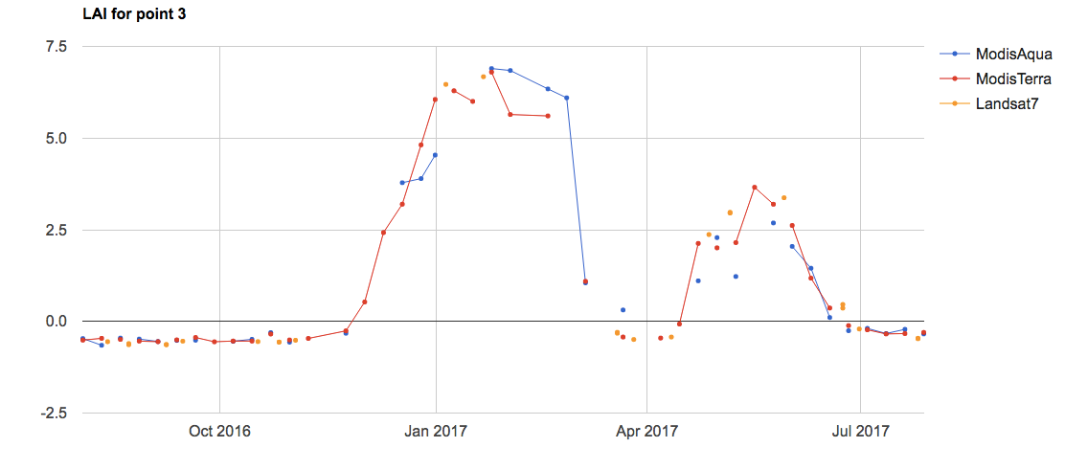
In GEE: Timeseries Analysis
Do only for single points in Matopiba for now
Overlay Modis Terra, Aqua and Landsat to compare visually – but Landsat looks very low!

Slide 4
In GEE: Timeseries Analysis
We have to split the year up into separate peaks; can’t use harmonic fitting to fit a double cropped year in one go
Issue with Modis: after filtering out clouds, the “no data” times have the wrong smoothed LAI result. Must be something about the way time is defined for the date of acquisition in Modis, because this isn’t an issue in Landsat. If we care only about timing of inflection, etc, then it should be ok because presence of clouds doesn’t seem to significantly impact timing of inflection point, max on the smoothed curve. If the data is extremely noisy, there will be a shift in timing of max smoothed LAI. For now, since the “look” of the fitted curve doesn’t actually affect the phase, amplitude, etc – just work with phase, amplitude to determine peak. Masking out with cloudmask got rid of the spurious points in the fitted function, but doesn’t change the actual csv output.

Slide 5
In GEE: Timeseries Analysis
Uses cloud filtering
Assumes a period of 1 year (ie single cropping only)
Fits to the function: LAI(t) = B + Acos(omega*t + phi)

Slide 6
In GEE: Timeseries Analysis v4
Only does harmonic fitting of a single point, in a single year, only for the soy curve.
Uses cloud filtered Modis Terra and Aqua to fit harmonic series
Fits to LAI, not another vegetation index (LAI was calculated using SR)
Step 1: “peak detection”
The purpose of this step is to estimate a rough location of the peak and period of the soy curve. This is necessary because the harmonic fitting we do needs to assume a period– if we want to estimate period in addition to amplitude and phase, we need to do a Taylor series approximation of the cosine function, and might run into more problems. Also need to find “start of season” because otherwise we would be fitting the “low LAI” stuff in the start and end of the timeseries in addition to the actual soy curve.
Begin by smoothing the cloud-filtered Modis timeseries using a 20 day moving average. Then smooth the smooth curve again using a 30 day moving average.
Calculate the (first order backward in time) derivative of the doubly smoothed timeseries. The derivative itself looks noisy, so smooth it with a 40 day moving average window. It is saved as an image collection
Find peak time: use qualityBand to search for the day of max (doubly smoothed) LAI
Find inflection time: use qualityBand to search for the day of max (smoothed) first derivative
For both the peak time and inflection time estimates, need to make sure we don’t take corn (second) peak as a soy peak. So set a second peak cutoff for the latest a maximum can happen by simply filtering out the later dates. We WILL have all data in the curve for harmonic fitting, so all that matters is that the second peak cutoff includes the actual soy peak. A danger is getting a really long estimate of period because the March 1 cutoff is too late; a danger is getting a really small weed peak and mistaking it for soy because the March 1 cutoff is too early; a danger is having a March 1 cutoff that’s a little bit before the actual peak. In this case the estimated peak will be a couple weeks too early. If this third case happens, the final harmonic fitting will still give the correct peak because harmonic fitting uses the whole soy curve; but period will be off. Add some more “linchpins” by setting a max/min allowed period and a min allowed amplitude?
Calculate period from the peak time and inflection time and approximate start of curve with the “minimum” LAI date by walking back half a period from the peak LAI date

Slide 7
In GEE: Timeseries Analysis v4
Step 2: harmonic fitting
For harmonic fitting, adjust the start of harmonic fitting to the “minimum” estimated LAI date from above. Also set the “period” as the period estimated from Step 1.
The data fitted to harmonic function will actually be truncated from the “start of season” (minimum LAI before peak) to the “end of season” (minimum LAI after peak) – this is to get rid of any interference by the low LAI parts of the timeseries that would pull down the amplitude
From the phase and estimate of the
Fits the original (non smoothed, cloud filtered) the function: LAI(t) = B + Acos(omega*t + phi)
Note: an advantage to this method is that it relies on the left side of the soy curve than on the left for determining period, which is great because the right side of the curve tends to be messier to deal with (due to double crop curve). Also, even if the cutoff is a bit too early, the peak location will still be okay because harmonic fitting includes a quarter period after the “smoothing-predicted” peak
However, if we filter out estimates by low/high period and low LAI amplitude, are we also systematically filtering out a class of soybean crop?

Slide 8
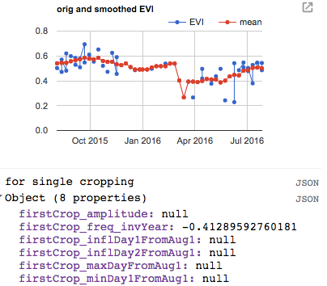
In GEE: Timeseries Analysis v5
For a point, look at harmonic fitting for both curves in a double cropped area. Did not change into images or functions yet.
In GEE: Timeseries Analysis v6
Turned v5 into image form. The peak date, etc information is stored in something called result image.
In GEE: Timeseries Analysis v7
Change from using LAI to using EVI
The resulting image of peak dates sometimes returns null if the timeseries of EVI is completely different from what the method can handle. The image will be empty on the null pixel.
Add mapbiomas cropland layer, lc_morgen (lc_morgen sometimes gives soy pixels in the middle of lakes…)
Use mapbiomas + lc_morgen to mask appropriate pixels in the result images… and need to produce and export as asset each year’s single and double cropping result images
Masked out pixels whose quarter periods are questionable and whose first and second peaks are within 20 days of each other
Export the result images for first and second peaks separately, and for each year.
Reapply method after get the resampled mapbiomas to same resolution as Modis and the new land cover map

Slide 9
To Do

Slide 10
To Do – LAI timeseries
Overlay the Matopiba/rally points with Land cover class in Mapbiomas and CAR field polygon data so we know that the LAI info was taken for an actual soy point rather than a road, etc. wait for Jake to do this. Jake will give me CAR polys – area explorada (which has managed regions only) – overlay this with Matopiba data points to see if the ones in area explorada have LAI values that make more sense. Match up Matopiba and CARpolys by farmer name
See if Dave or Jake can upload GOME data. See if Avery gets STAIR information.
as soon as the LC is updated, write up a one pager explaining and justifying the approach and showing summary stats, visualizations, and validation (e..g with the matopiba survey data on planting date and harvest date). if all looks good, then great. otherwise, the next step might be to work on improvements
also, i do think you should explore an approach that lets you use some goodness of fit type metric to let you select your frequency parameter in your harmonic curve fitting scheme.

Slide 11
To Do – Planting/Harvest from Phenology
Export Matopiba planting/harvest date data using GEE
Use data about variety to get cycle length information, which can then inform the frequency of the wavelet used to smooth EVI series
Gabriel will send information on the relationship between planting date and observed emergence
Put in GEE a way to get a sense of the spread in planting, harvest dates and how different pixels look from each other
Separate weed peaks from crop peaks; Think about an algorithm to divide the timeseries into chunks in which we expect a planting and a harvest date.
Look for peak detection methods (i.e. filter out the weed peaks by looking at thresholds in peak characteristics).
Fit planting date to onset map for running hypothetical pixels. Ask for onset map from Gabriel.
Overlay MODIS and Landsat for a one-week plant/harvest attempt. Use harmonic smoothing in GEE to start smoothing LAI curve.
Summer Crop Model
Idea: bisect by before and after peak LAI, calculate the climate variables before and after it, then train the crop model. We’re talking about a local fixed effects (“de-meaning”). Approximate peak LAI using change in onset. Then the climate variables (before and after peak) will depend on the time of the peak date.

Slide 12
Tasks – from Zoho
Mask of single/double cropped areas – pick the Morgen class for the Rally pixels so Gabriel can see how they relate to onset-greenup
Soy classification maps: Obtain all relevant soymaps and decide on combining maps if necessary. overlay Pequisa agri municipal data as a “check”
Determine representativeness of yield data
Sample new soy pixels
Phenology calculations (planting, harvest estimates) for all sampled soy pixels
Going Forward
Think about paper on plant/harvest date. Will it be a methods paper (RS? Hydrology? Agri?) or application paper?
Notes:
All weather data will be interpolated (Tmin, Tmax, Tavg, wind speed, specific humidity, precip, radiation); interpolation will happen during the process of going from pixel to list
Classify pixels into region in the native weather data grid
Ask Dave – what does he do for gridded weather? What dataset does he use? Does he interpolate?
My work:
Bottleneck: Ask about datasets. Ask about cyberinfrastructure. Need: onset, Rally da Safra, LC Morgen soymap, Mapbiomas, other land use classifications, single vs double crop maps
Compile soymap and yield data
Determine rep of yield data
Select new soy pixels if necessary
Tie LAI info to the selected and yield soy pixels

